Slide 1

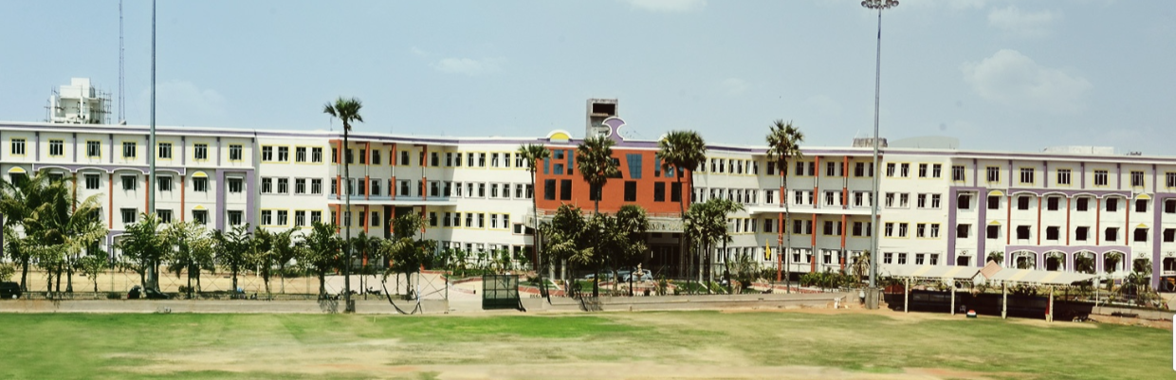
OFFICE STAFF MANAGEMENT SYSTEM
Name Reg.No
CH. SAI SAMPADA 21K91A6724
CH. SRIKAR 21K91A6726
M. PAVANKUMAR 22K95A6707
Guide Name
Mr.K.Srinivas Reddy Asst.prof
CSE (DATA SCIENCE)

Slide 2
OUTLINE OF PRESENTATION
Introduction
Abstract
Existing system
Limitation of Existing system
Proposed System
Literature Survey
Literature Survey Analysis
Objectives
Architecture & Explanation
List of Modules & Sub modules
Screen Shorts
Conclusion
References
CSE (DATA SCIENCE)

Slide 3
INTRODUCTION
Office staff management system is a software that helps business organize & manage their employee their schedules & other important information.
Good office management makes us business run smoothly & increases our profit.
Office management training modules provides learning materials & exercises on how to efficiently & effectively manage an office & covers a range of subject.
This system is an application based system having two applications developed.
For employers to manage employee details
For employers to mark their attendance
This project seeks to simplify staff management process & promote better communication within organization.
CSE (DATA SCIENCE)

Slide 4
ABSTRACT
Office management system are software programs & applications that aim to streamline the various functions of an office manager such as planning, organizing, coordinating, controlling, staffing & supervising. An office management system keeps everyone in the company on the same page through enhanced coordination & communication.
This system could communicates staff complications to administrators which it can boost employee moral. It incorporates robust security measures to safeguard sensitive employee information.
CSE (DATA SCIENCE)

Slide 5
Existing system
The security of office management system analysis system which mainly deals with the networked office. through which it maintains. the complicated staff structure and manages all the department levels.
This systems will enhances the safe transmission of data & manages all the documents on the internet.
This system will support the state & enterprises by over coming the losses occurred due to the employee's Sabotage.
This system established an information system security model based on lotus Notes.
CSE (DATA SCIENCE)

Slide 6
Limitation of Existing system
The existing system may be helpful in managing the data of a campion staff structure at different levels, but it demerits which need to be overcome by the new system for letter write better.
This system is based on a database design where still the sabotage of employee details may occur and the details may mislead to the specified information.
As of in olden days all the data is hand coded and finding the such data of my person was very difficult and takes time.
The main disadvantage is intrudes can access a fellow employee's sensitive data, it might lack the security of the data.
CSE (DATA SCIENCE)

Slide 7
Proposed System
In a proposed office staff management system, the focus is on automating and streamlining various administrative tasks.
This system may include features such as employee onboarding, attendance tracking, leave management, performance evaluations, and payroll processing.
The main objective of this system is to design a computerized office system that will take care of the staff payroll and to design a computerized system for calculating basic salary and allowance of staff.
This will enhance the network security prevents information leakage maintaing and stealing of employee’s information.
The goal is to create a more efficient and organized workflow for managing the office staff.
CSE (DATA SCIENCE)

Slide 8
Literature Review
Smart attendance system based on frequency distribution algorithm with passive RFID tags
Qianwen Miao; Fu Xiao; Haiping Huang; Lijuan Sun; Ruchuan Wang
Theme :
Staff attendance information, which is closely related to salaries and bonuses are important standard for companies. Integrated-circuit card check-in is a common approach used to verify work attendance.
However, this unsupervised approach can lead to false records for opportunistic individuals who consign others to punch their cards, which negatively affects the effectiveness of staff management. To reduce the occurrence of this phenomenon, a fingerprint attendance system has been proposed.
The rapid development of Radio Frequency Identification (RFID) technology, RFID now has the potential to distinguish between different people. Compared with traditional attendance mechanisms, RFID-based attendance systems are based on living biometrics, which greatly reduces the possibility of cheating.
CSE (DATA SCIENCE)

Slide 9
Advantages :
A device-free office attendance system based on RFID that can distinguish between different individuals based on their features
Instead of extracting a single phase value for target recognition, it extracts multiple evaluation indicators from a statistical frequency distribution histogram of phase profiles that correspond to each volunteer
Disadvantages:
It’s possible for fraudsters to fake a fingerprint image and trick the system.
Hygiene is also a problem since employees must directly touch the machine when checking in.
CSE (DATA SCIENCE)

Slide 10
Literature Review
Design of Employee management application for small medium Enterprise
Published in 2021 International Conference on Information Management and Technology on 14th
Linus Steven Sanjaya, Ferdianto, Titan
Theme:
The design of an Employee Management Application for Small and Medium Enterprises (SMEs) is a strategic endeavor aimed at enhancing operational efficiency and human resource processes within the organization. A well-crafted application should prioritize simplicity in its user interface, ensuring that even non-technical users within SMEs can easily navigate and utilize its features.
Cost-effectiveness is a crucial merit, as SMEs often operate under budget constraints. The application should offer essential functionalities without requiring significant customization or extensive training. Scalability is another key consideration, allowing the application to grow seamlessly alongside the SME, accommodating an expanding workforce and increasing data volumes without necessitating substantial redesign.
CSE (DATA SCIENCE)

Slide 11
Advantages :
A user-friendly interface with intuitive design simplifies the employee management process, making it accessible for non-technical users within SMEs.
SMEs often have budget constraints. A well-designed application can be cost-effective, providing essential functionalities without the need for expensive customization or extensive training.
Disadvantages:
Out-of-the-box solutions may have limitations in customization. SMEs with unique processes may find it challenging to tailor the application to meet specific requirements.
Introducing a new application may require training for employees and HR staff, leading to a temporary decrease in productivity during the learning curve.
CSE (DATA SCIENCE)

Slide 12
Literature Review
A Visual Analytics System for Evaluating Employee Performance in Public Safety Agencies
Jieqiong Zhao; Morteza Karimzadeh; Luke S. Snyder; Chittayong Surakitbanharn
Theme:
Organizational performance evaluation can be useful for strategic planning, staff management, and operational development. An effective performance evaluation system with clearly defined goals and prompt feedback is essential for organizations to improve their productivity.
it can be beneficial to interactively analyze, visually explore, accurately weight, compare, and evaluate employee performance in the context of organizational hierarchy.
Metricsv is , a visual analytics system for evaluating the performance of individual employees, teams, and the entire organization in public safety agencies.
CSE (DATA SCIENCE)

Slide 13
Advantages:
System contains four visual components to support interactive visual analysis of organizational performance with a set of hybrid evaluation metrics, integrating subjective ratings and quantifiable outcomes of job activities at multiple grouping granularities.
Disadvantages:
It does not include the time associated with job types as another contributing factor in the final performance outcome, since the time to complete a particular problem is of interest regardless of the domain.
CSE (DATA SCIENCE)

Slide 14
Literature Review
Security of office management information system analysis
Rishabh Bajpayi,Prof. M L Sharma, K C Tripathi
Theme:
Every organization keeps a record of their staff. Staff records play a crucial role in staff management. Every organization requires these records to calculate pay, manage workforce and see performance of employees. Management of all these records is a challenging task and time consuming process for the HR team, which can be reduced by using EMS
EMS is also an informatics system that is useful in saving time, power and money of owner, HR’s and manager that is the Employee Management System. This system consists of two mobile applications which one for HR team to manage employees and another for Employee to mark their attendance.
CSE (DATA SCIENCE)

Slide 15
Advantages:
Security measures safeguard sensitive data, including employee records, financial information, and organizational strategies, protecting against unauthorized access and potential breaches.
A secure office management information system fosters trust among users, including employees, management, and external stakeholders.
Disadvantages:
Implementing and maintaining robust security measures can be expensive, requiring investments in technology, training, and personnel.
Human error remains a significant factor in security breaches, and ensuring that employees are well-trained and aware of security protocols can be challenging
CSE (DATA SCIENCE)

Slide 16
Literature Review Analysis
As per the above study provided by various authors aims to give a brief information of managing the office staff automation through the evaluation of attendance, organizational performance, payroll, security etc. The most appropriate way of solving the issue of security breach is to use the multi factor authentication ,though it consists some limitations but overcomes the security measures .Though the above mentioned systems deals with the time power and savage of money ,simplifies the process of maintenance of records, the major issue is absence of two step verification for office management system to enhances the security.
CSE (DATA SCIENCE)

Slide 17
Objectives
Data accuracy
Attendance and leave management
Strong authentication
Efficiency
Cost control
CSE (DATA SCIENCE)

Slide 18
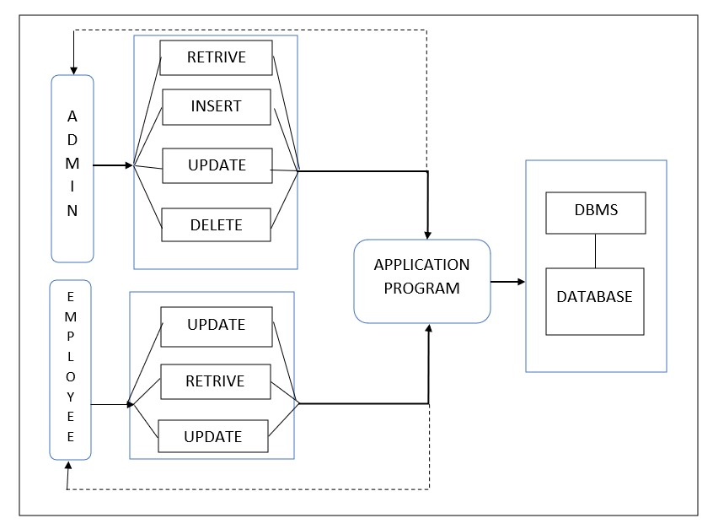
System Architecture
CSE (DATA SCIENCE)

Slide 19
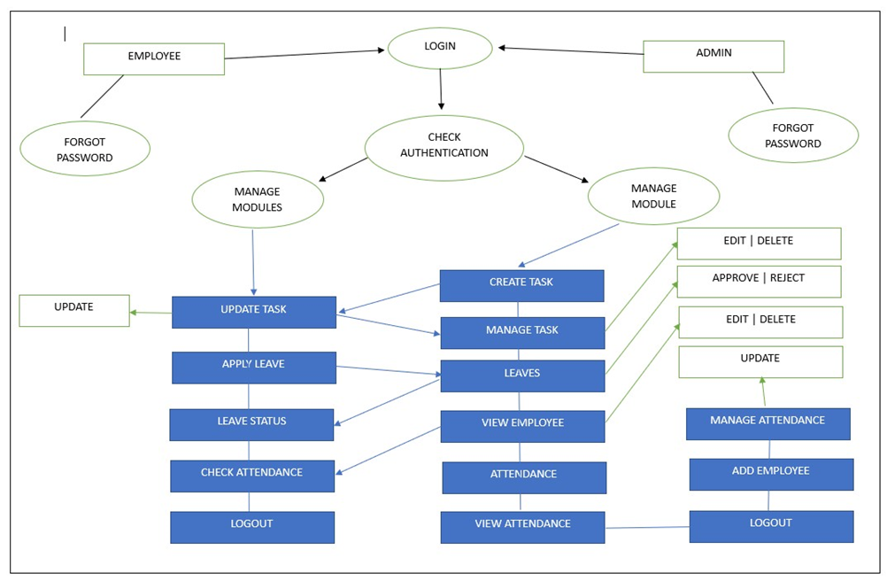
Data Flow Diagram
CSE (DATA SCIENCE)

Slide 20
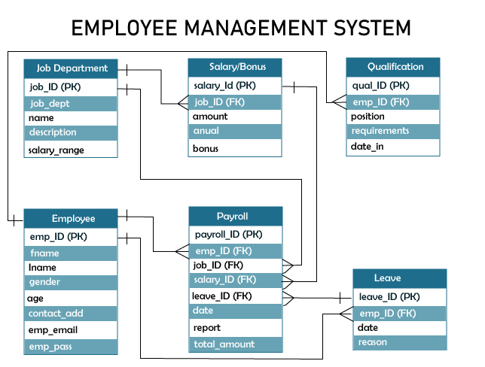
Relationship Table
A database design is a collection of stored data organized in such a way that the data requirements are satisfied by the database. The general objective is to make information access easy, quick, inexpensive and flexible for the user. There are also some specific objectives like controlled redundancy from failure, privacy, security and performance. A collection of relative records make up a table. To design and store data to the needed forms database tables are prepared.
CSE (DATA SCIENCE)

Slide 21
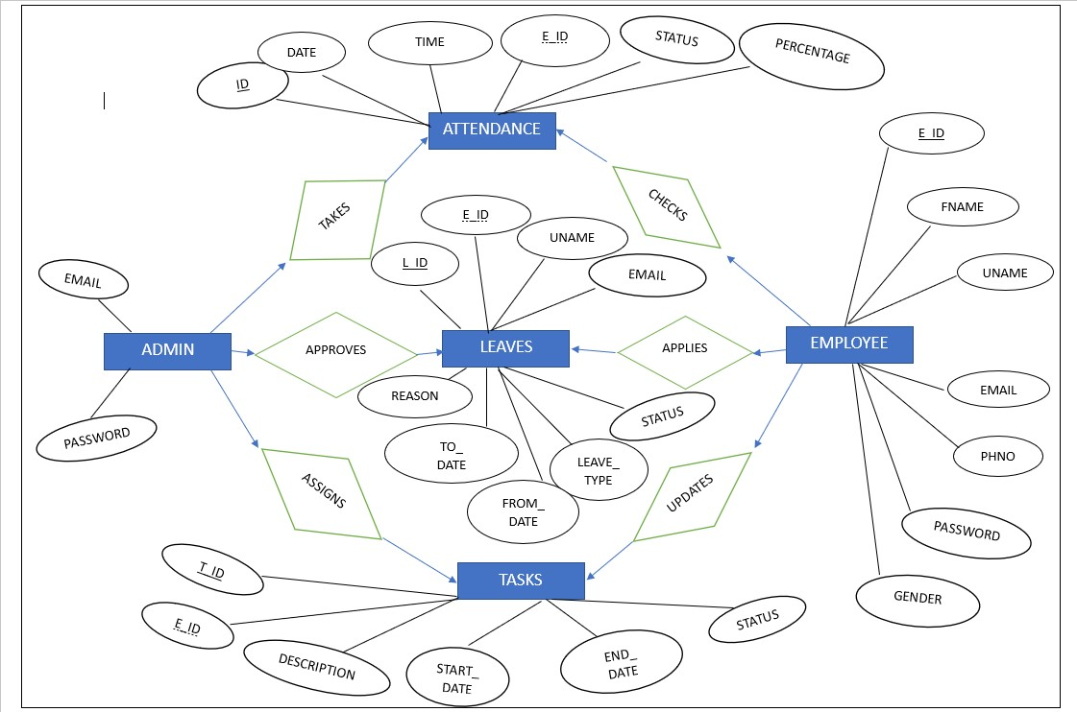
Entity Relationship Diagram
A database design is a collection of stored data organized in such a way that the data requirements are satisfied by the database. The general objective is to make information access easy, quick, inexpensive and flexible for the user. There are also some specific objectives like controlled redundancy from failure, privacy, security and performance. A collection of relative records make up a table. To design and store data to the needed forms database tables are prepared.
CSE (DATA SCIENCE)

Slide 22
List of Modules & Sub modules
ADMIN LOGIN
ADD EMPLOYE
CREATE TASK
EMPLOYE LOGIN
APPLY LEAVE
UPDATE TASK
CONTACT US
ADDRESS
CONTACT INFORMATION
HELP
FAQS
FEEDBACK
ABOUT US
CSE (DATA SCIENCE)

Slide 23
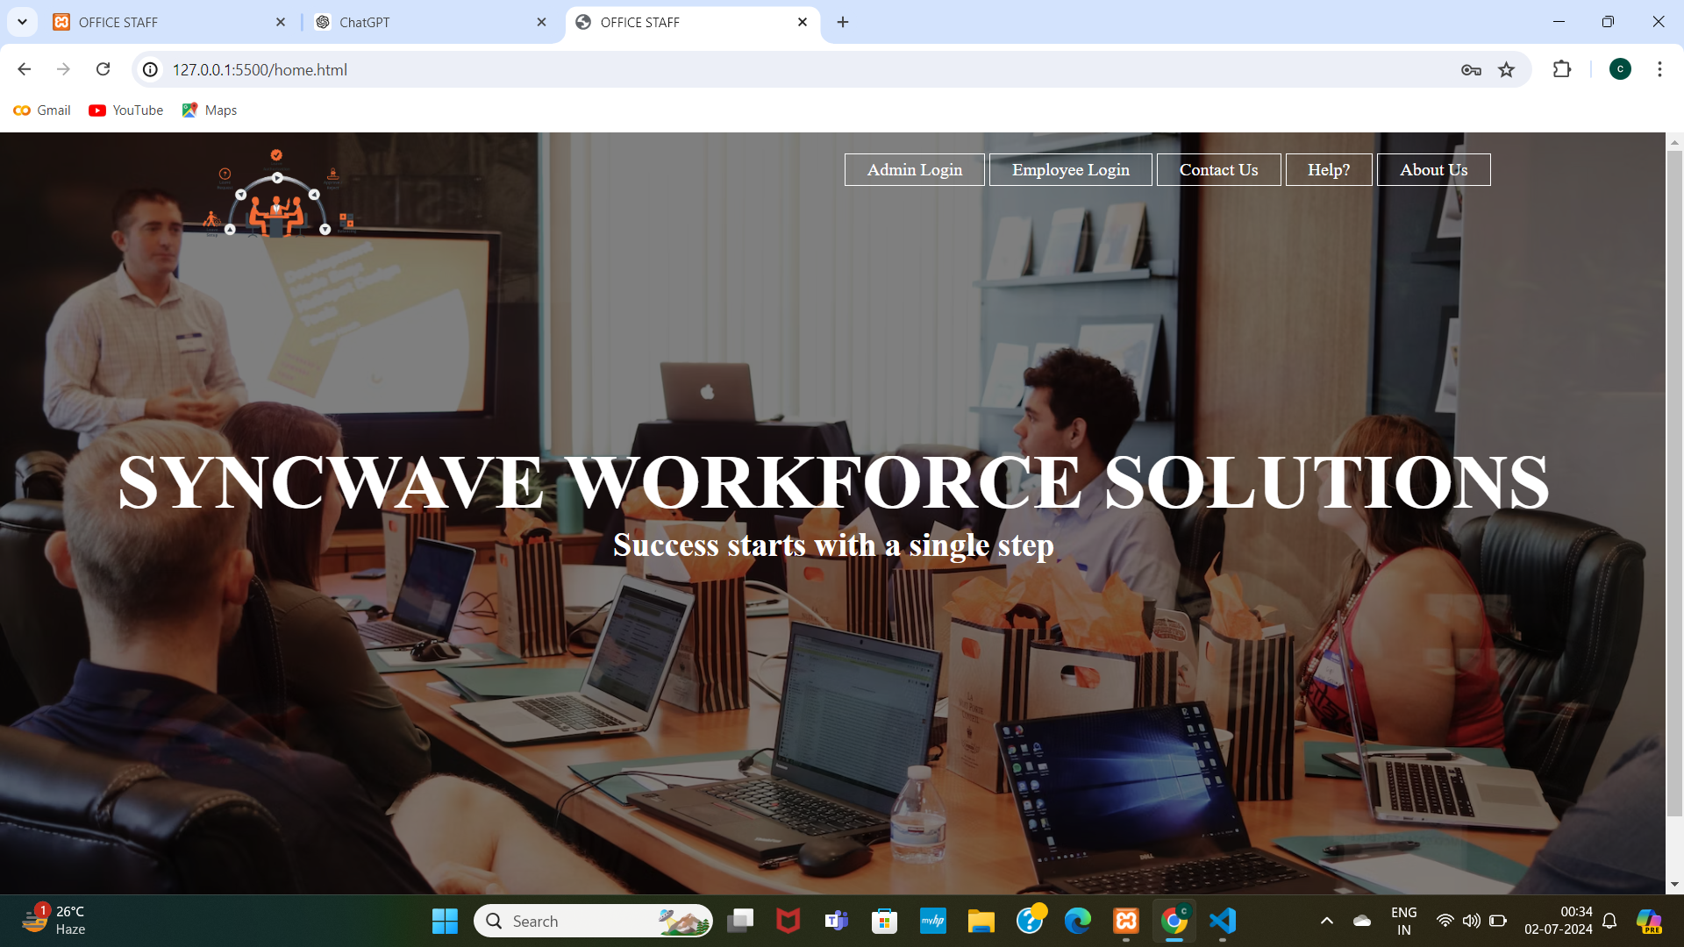
Home Page Design
CSE (DATA SCIENCE)

Slide 24
Module 1:Admin Login
SUB MODULES:
CREATE TASK
ADD EMPLOYE
MANAGE TASK
LEAVES
VIEW ATTENDENCE
MANAGE ATTENDENCE
CSE (DATA SCIENCE)

Slide 25
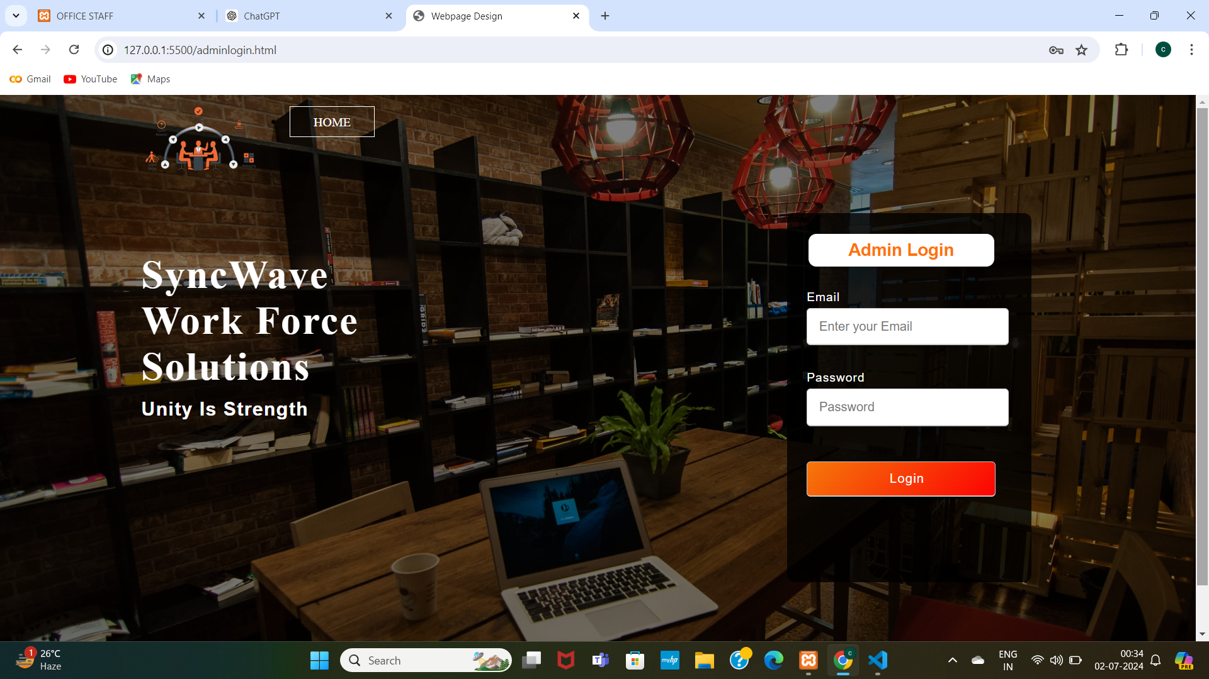
Modules 1:Admin Login
CSE (DATA SCIENCE)

Slide 26
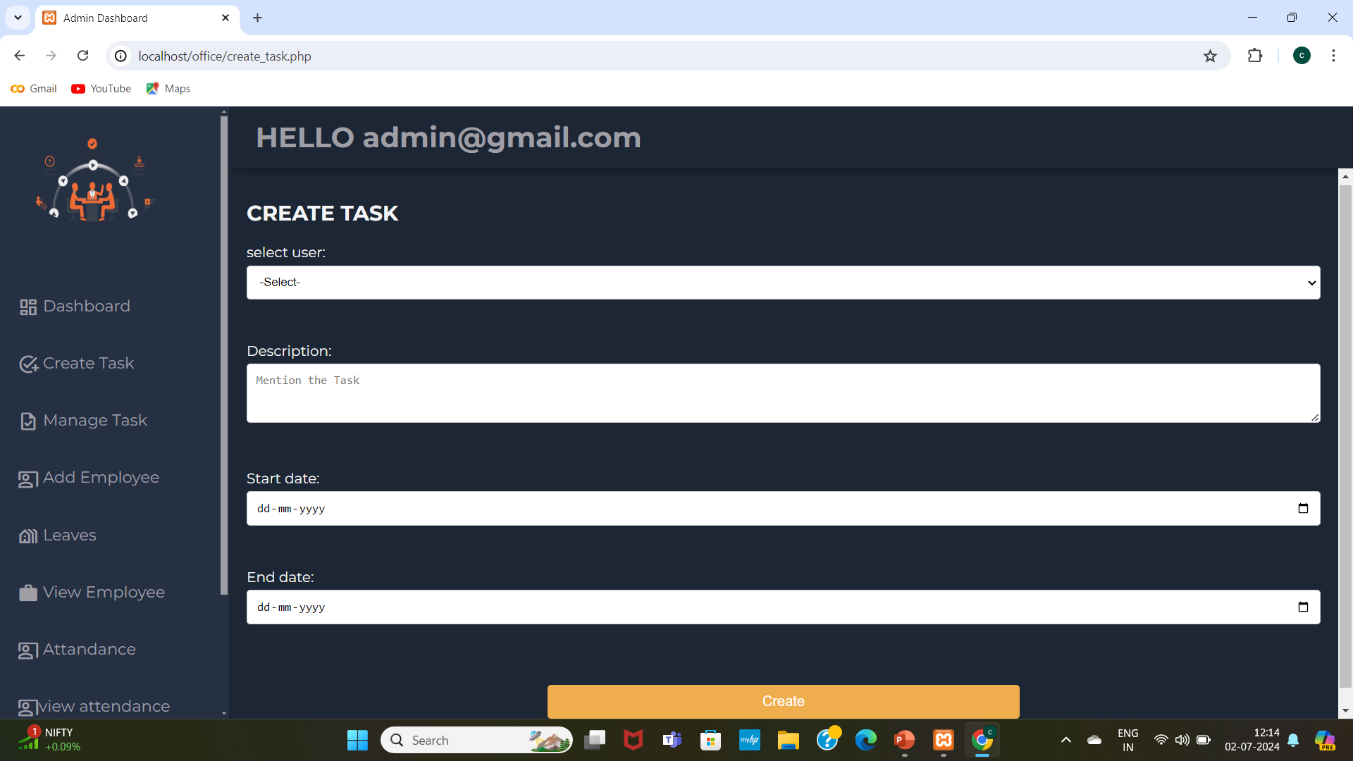
Sub Module 1:Create Task
CSE (DATA SCIENCE)

Slide 27
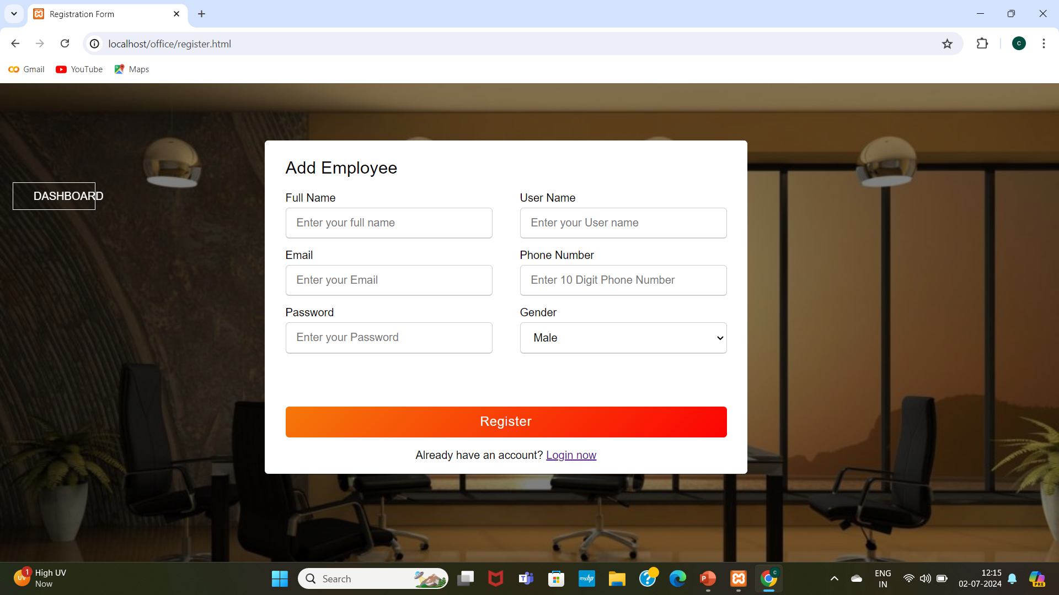
Sub Module 2 : Add Employe
CSE (DATA SCIENCE)

Slide 28
Module 2:Employee Login
SUB MODULES:
UPDATE TASK
APPLY LEAVE
LEAVE STATUS
ATTENDANCE
CSE (DATA SCIENCE)

Slide 29
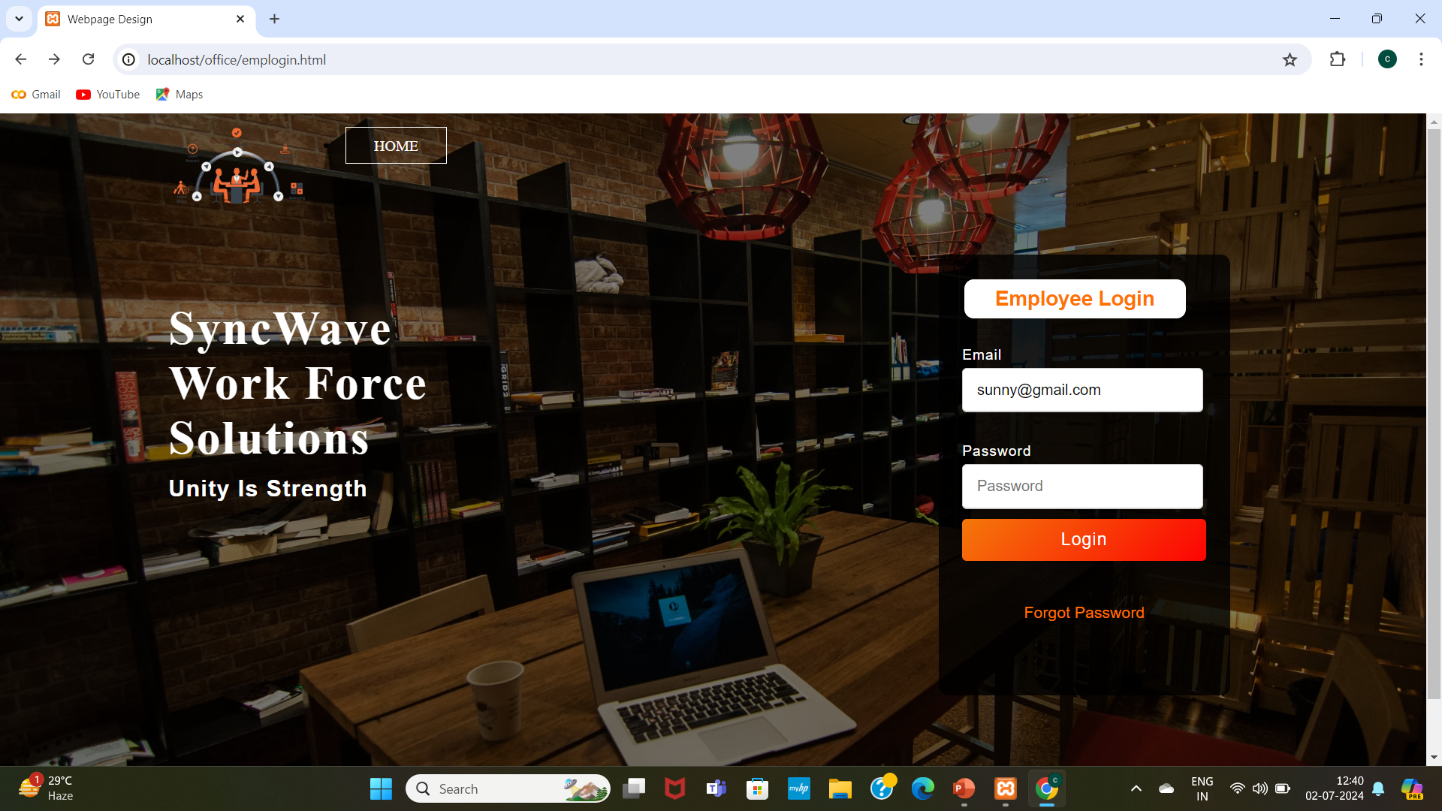
Module 2:Employee Login
CSE (DATA SCIENCE)

Slide 30
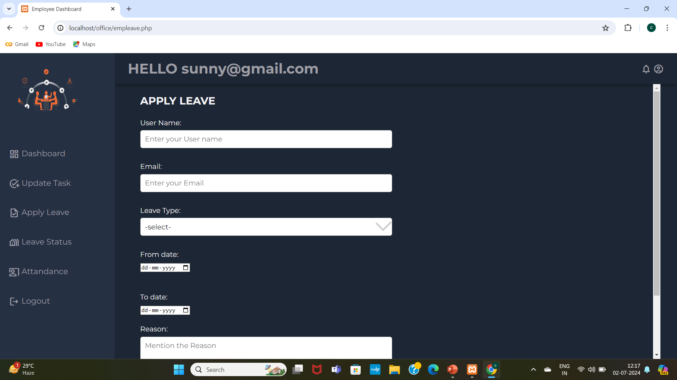
Sub Module 1:Apply Leave
CSE (DATA SCIENCE)

Slide 31
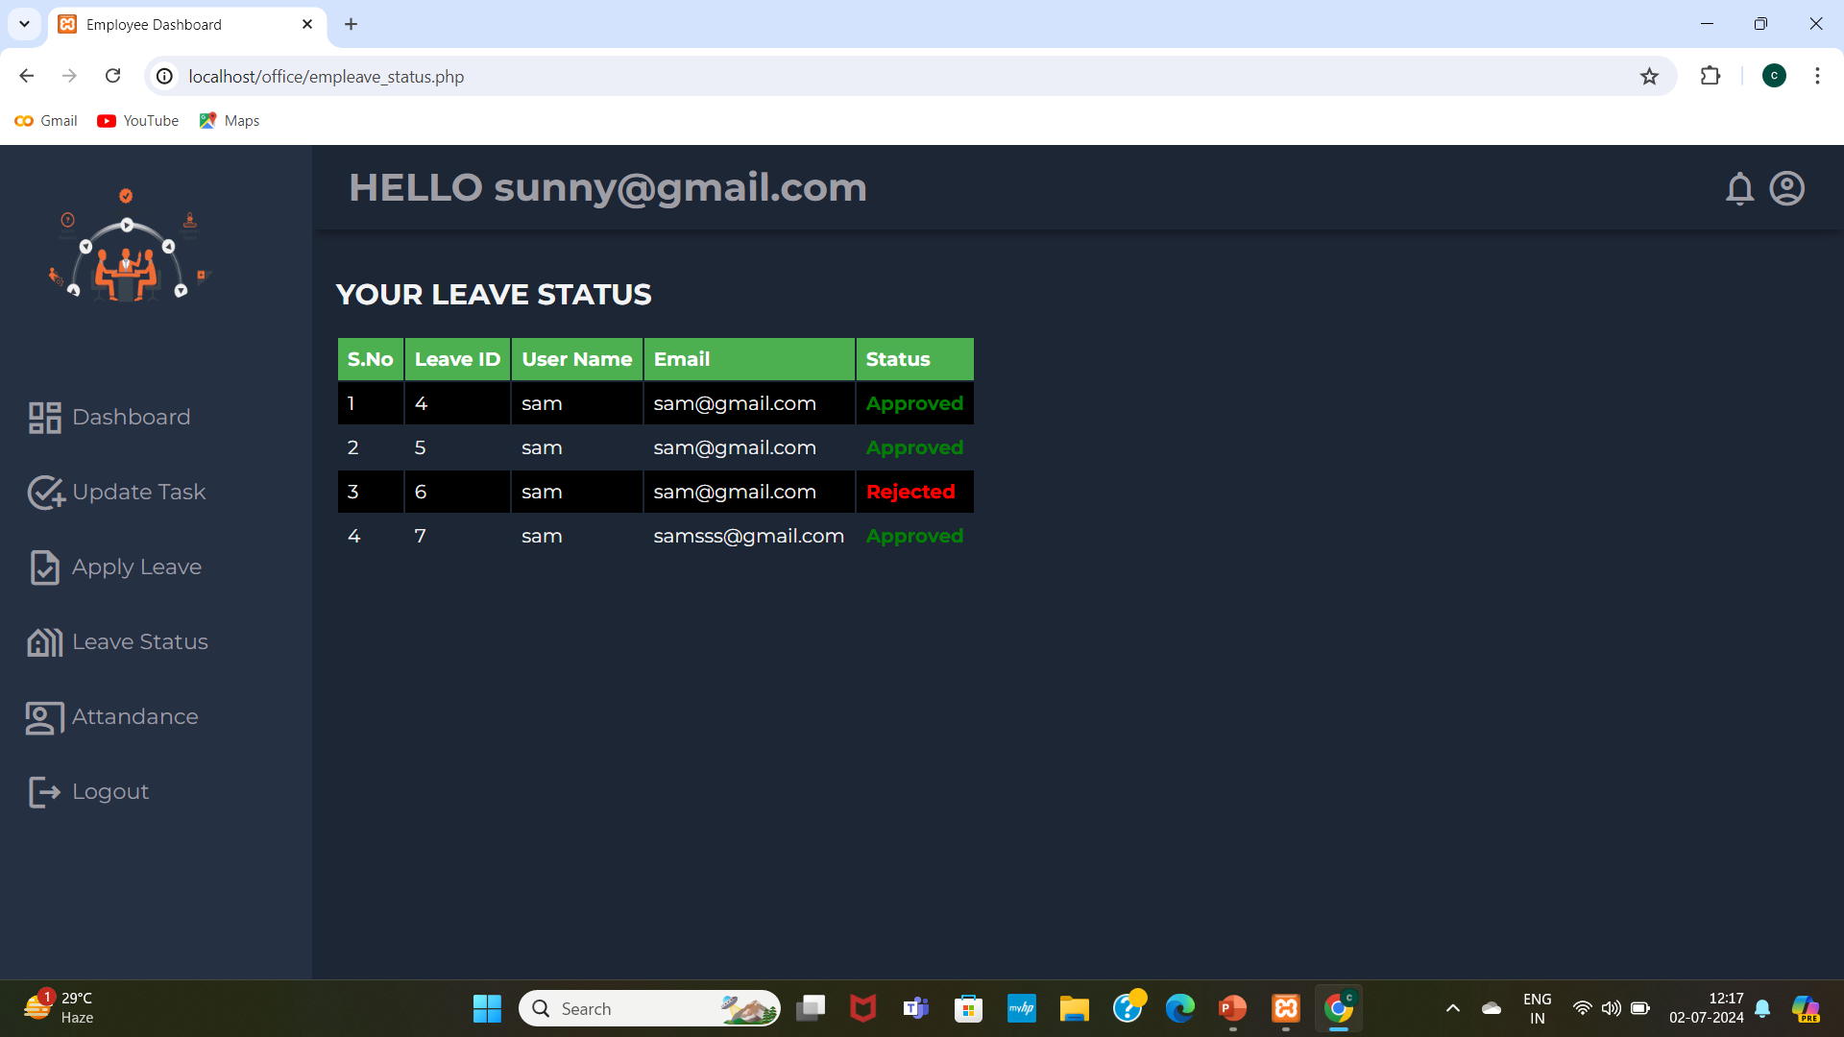
Sub Module 2:Leave Status
CSE (DATA SCIENCE)

Slide 32
Module 3: Contact Us
SUB MODULES:
ADDRESS
CONTACT INFORMATION
CSE (DATA SCIENCE)

Slide 33
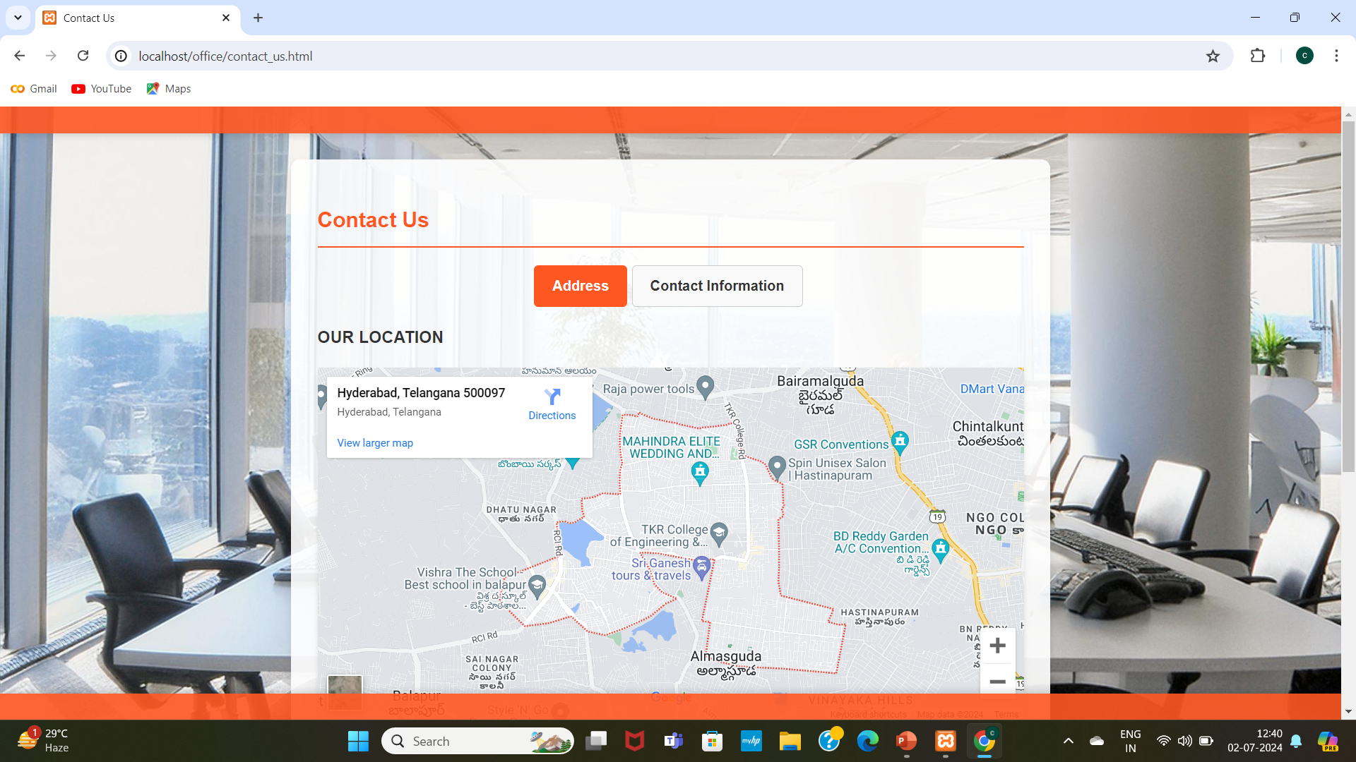
Module 3:Contact Us
CSE (DATA SCIENCE)

Slide 34
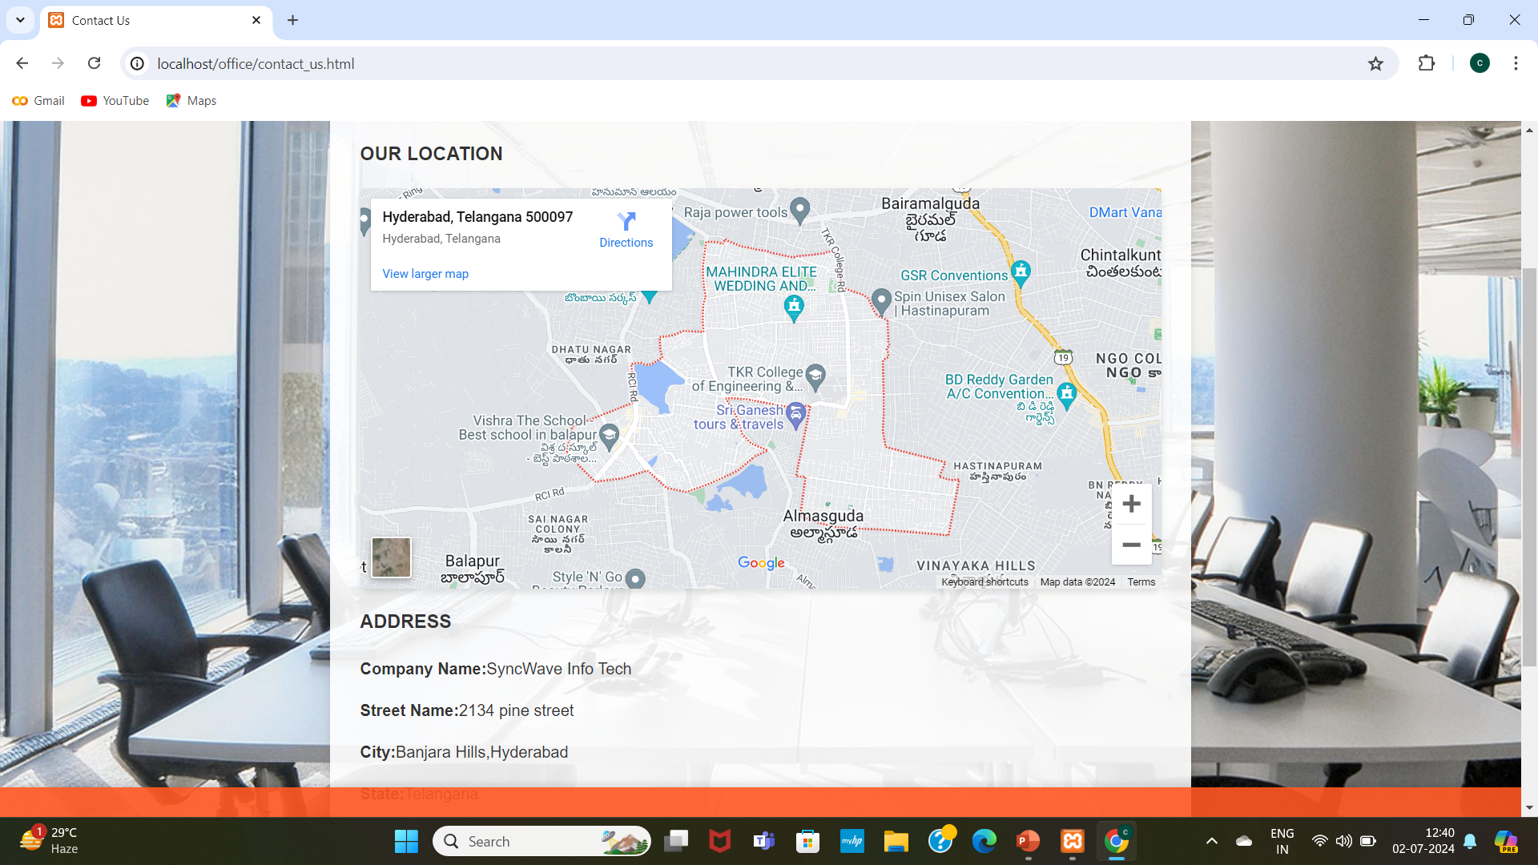
Sub Module 1:Address
CSE (DATA SCIENCE)

Slide 35
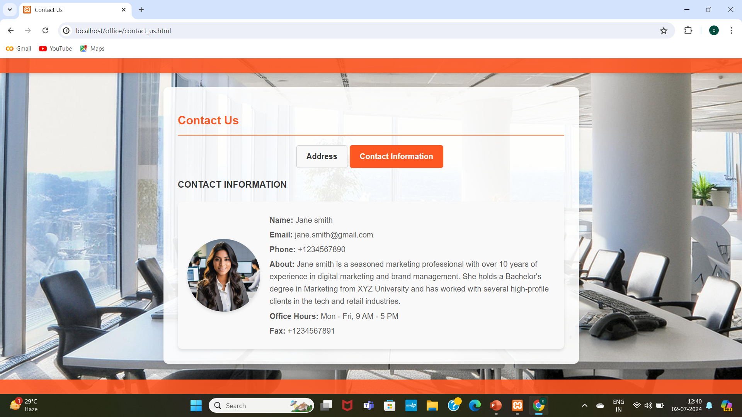
Sub Module 2:Contact Information
CSE (DATA SCIENCE)

Slide 36
Module 4: Help?
SUB MODULES:
FAQS
FEEDBACK
SEND A MESSAGE
CSE (DATA SCIENCE)

Slide 37

Module 4: Help?
CSE (DATA SCIENCE)

Slide 38
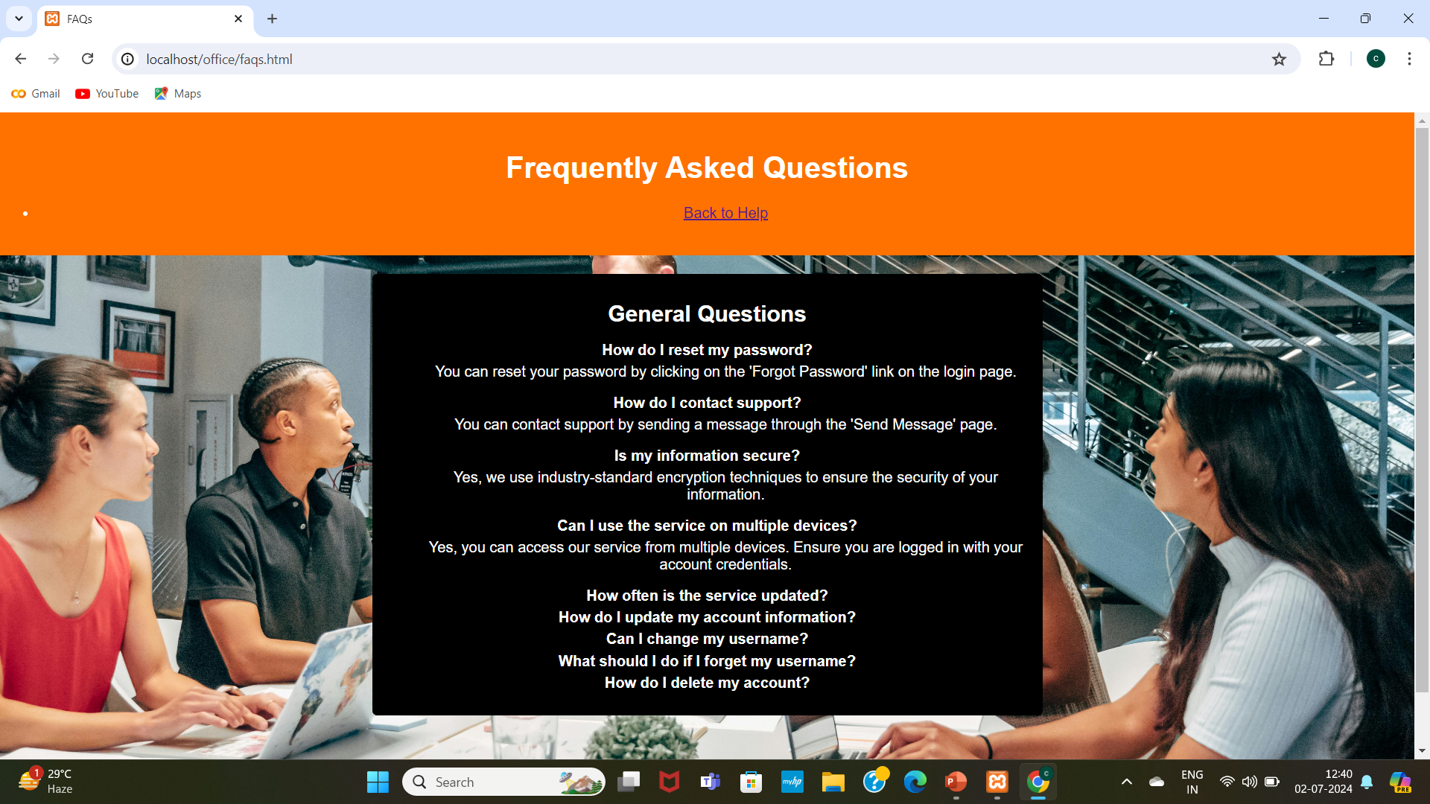
Sub Module 1:FAQS
CSE (DATA SCIENCE)

Slide 39
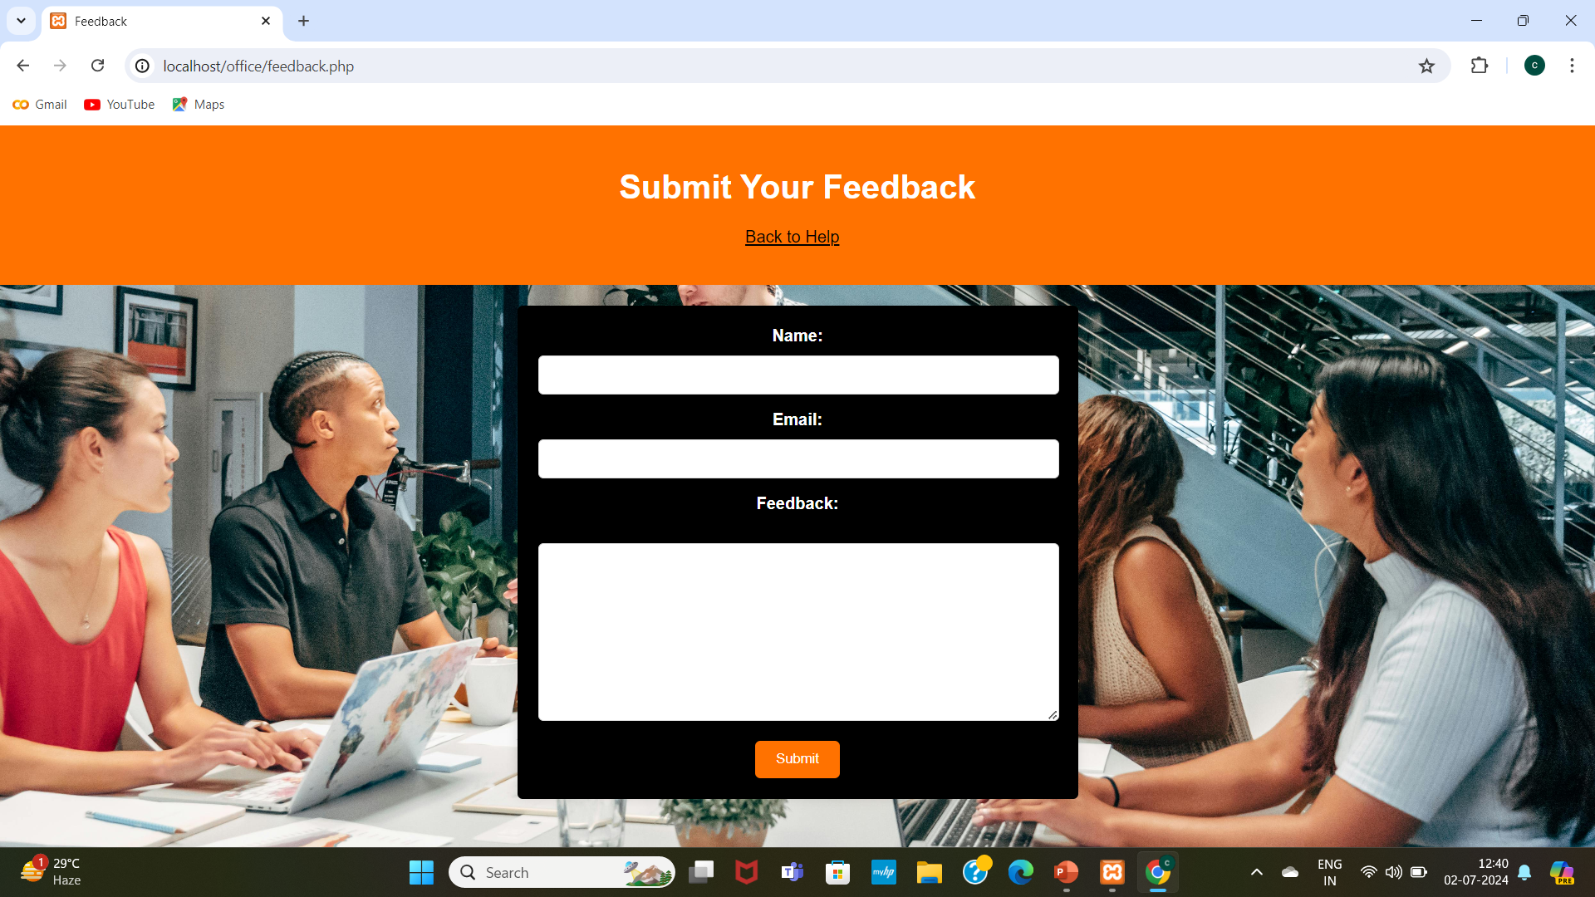
Sub Module 2:Feedback
CSE (DATA SCIENCE)

Slide 40
Overview About The Modules
The Homepage consists of Employee Login , Admin Login and About us.
The Employee Login consists of employee login details and dashboard where it holds information about the employee leave marking ,task updating, leave application , leave status, attendance ,logout.
The Admin Login consists of admin login details and dashboard where it holds information about the addition of an employee , creating and managing the tasks and employees attendance tracking .
Each page consists of Home button to return to the Home page.
CSE (DATA SCIENCE)

Slide 41
Conclusion
In conclusion, the Office Staff Management System has been successfully developed to streamline and automate various administrative tasks within an office environment. This system enhances efficiency by providing a centralized platform for managing staff records, tracking attendance, and facilitating communication among team members. The implementation of this system has resulted in improved accuracy, better resource management, and overall increased productivity within the office.
Moving forward, there are several key areas where further improvements can be made to enhance the system's capabilities. One critical aspect is the implementation of stronger authentication mechanisms to ensure data security and protect sensitive information from unauthorized access. By continually evolving and incorporating these enhancements, the Office Staff Management System can remain a robust and invaluable tool for office management.
CSE (DATA SCIENCE)

Slide 42
References
Base reference :https://ieeexplore.ieee.org/document/5603739
Reference 1 :https://ieeexplore.ieee.org/document/8821515
Reference 2 : https://ieeexplore.ieee.org/document/9534990
Reference 3 : https://ieeexplore.ieee.org/document/8805443
CSE (DATA SCIENCE)

Slide 43
References
[1]David S. Ebert Morteza Karimzadeh,Luke S. Snyder,Chittayo,Zhenyu,Cheryl Qian, Security of office management information system analysis, Published in 2019 on 19th august (URL: https://ieeexplore.ieee.org/document/5603739).
[2] Lijuan Sun, Qian Wen Miao, Fu Xiao, Haiping Huang, Ruchuan Wang, Security of office management information system analysis, Published in 2019 by Tsinghua Science and Technology on 2nd September by Lijuan Sun, QianwenMiao,FuXiao,HaipingHuang,RuchuanWang(URL:https://ieeexplore.ieee.org/document/5603739).
[3]Chang Sheng, Yang Chenghui, Wu Xiaojun, Design of Employee Management Application for Small Medium Enterprise, Published in 2010 Second IITA International Conference on Geoscience and Remote Sensing on28th August (URL:https://ieeexplore.ieee.org/document/9534990).
[4]Linus Steven Sanjaya, Ferdianto, Titan, MetricsVis: A Visual Analytics System for Evaluating Employee Performance in Public Safety Agencies, Published in 2021 International Conference on Information Management and Technology on 14th September (URL: https://ieeexplore.ieee.org/document/8805443).
[5]WPlimmer, B., & Apperley, M. (2007). Making paperless work. ACM International Conference Proceeding Series, 254(June 2014), 1–8. (URL:https://doi.org/10.1145/1278960.1278961).
CSE (DATA SCIENCE)

Slide 44
References
[6]Grindei Laura; Orza Bogdan; Ciupe Aurelia; Meza Serban, University Learning Management System based on Office 365 (URL: https://ieeexplore.ieee.org/document/8424799).
[7]Haiqiang Zhang; Tianli Zhang, Research on the comprehensive information system of office administration under computer big data technology, 2018 17th International Conference on Information Technology Based Higher Education and Training (ITHET) (URL: https://ieeexplore.ieee.org/document/9997083).
[8]Muhammad Tayyeb; Syed Zulqadar Hassan; Tariq Kamal; Umar Riaz; Amir Zahoor; Muhammad Abbas Khan; Muhammad Awais, Sensor Based Smart Office Control System 2019 International Conference on Electrical, Communication, and Computer Engineering (ICECCE) (URL:https://ieeexplore.ieee.org/document/8940809).
[9] Wisted fantasy, Office staff management system, Published in github.com by (URL: https://github.com/twistedFantasy/staff).
CSE (DATA SCIENCE)

Slide 45

CSE (DATA SCIENCE)

